Slide 1

Empirical Evaluation of the Resilience of
Novel S-Box Implementations Against
Power Side-Channel Attacks
Master’s Degree in Computer Engineering
Candidate: Samuele Yves Cerini
Supervisor: Paolo Ernesto Prinetto
Notes:
First of all thank you for being here
I’ll present my thesis which consisted on an empirical evaluation of Novel SBox structures to test their resistance against side-channel attacks

Slide 2
Outline
Side-Channel Power Analysis
  Definition and goals of the attack
Countermeasures against SCA
  Rationale
  Problems
  Why S-Boxes?
Thesis Contribution
  Motivations
  Results
  Conclusions and Future Work
Q&A
Notes:
Before presenting my thesis work I would like to introduce you to the topic, starting by a brief overview on side-channel power analysis
We will then dig into the available countermeasures also listing the problems they pose to IoT and embedded devices, finally explaining why S-Boxes are so important
I will then introduce my thesis work, exploring the motivations behind it, discussing the results obtained and the possible future work
And finally I will leave you to any questions you may have

Slide 3
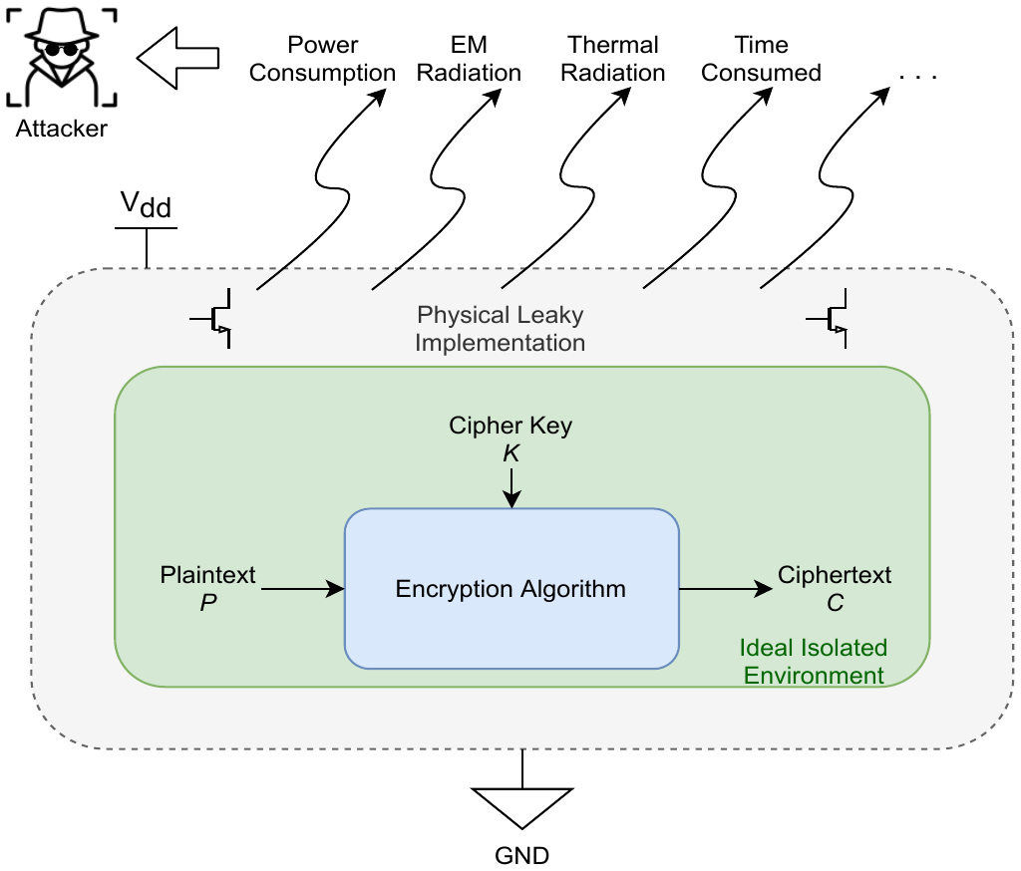
Side-Channel Power Analysis
Side-channel Analysis (SCA):
Goal:
  Retrieve sensitive data
    cryptographic keys
  Targets operating devices
    IoT devices, embedded systems
More efficient than classical cryptanalysis
  More convenient for an attacker, less data needed
Power Analysis (PA):
Simple Power Analysis (SPA)
  Visual analysis
  A single power trace may be sufficient
Differential/Correlation Power Analysis (DPA/CPA)
  Based on automated statistical computations
  Multiple power traces are needed
Notes:
Side channel analysis is a class of attacks targeting physical emissions produced by an operating device. The goal is to correlate them to the sensitive data handled internally, such as cryptographic keys.
Some observable parameters are, for instance:
→ The power consumption
→ The electromagnetic radiations
→ The time required to complete a certain operation etc…
For this thesis we focused on the power consumption aspect of a device, so we will refer specifically to power attacks.
Power analysis is being used to break SW and HW implementations of the AES block cipher algorithm, RSA and Elliptic Curves Cryptography
We can distinguish among operation-related observations, done with Simple Power Analysis and data-dependent observations

Slide 4
Countermeasures against SCA - Why S-Boxes?
Physical emissions cannot be prevented, but…
Leakage can be reduced
What cannot be prevented can be “scrambled”
Problem:
  High impact on performance and code size
  Small embedded devices cannot afford such impact
Solution:
  Move to the mathematical level, which is device-independent
Why target the S-Box structure?
Crucial component for many block ciphers
Look-Up-Table
  Low memory impact (4x4 or 8x8)
Flexible
Automated heuristic design is possible
Notes:
When dealing with side-channel analysis, countermeasures do exists but perfect countermeasures are impossible to achieve.
This is due to the fact that every transition from one state to the other is not reversible, in pure thermodynamic terms.
The second problem is that countermeasures at the device level cannot be implemented on small embedded systems, as their impact on performance cannot be tolerated
The solution is to implement countermeasures at the logical level, which is device independent.
Research focused on S-Box structures since they are a crucial component of current block ciphers
They consists of a 8x8 matrix, used as a look up table
They provide the so called Shannon Confusion into the cipher
Moreover, they can be modified w/o modifying the rest of the algorithms, and finally they can be designed using automated heuristic algorithms

Slide 5
Thesis Contribution
Observation:
A plethora of novel S-Box have been proposed:
  designed with novel methodologies
    pseudo-random generation
    chaos-based methods
    heuristic methods
  many claim a theoretical resistance against SCA
  most of these structures never left simulations
Theoretical metrics do exist:
  still in development
  their effectiveness must be proven
    Transparency Order
    Improved Transparency Order
    Confusion Coefficient
Motivations:
An empirical evaluation is needed:
  to benchmark the State of the Art of S-Box structures
  to correlate the metrics with their claims
Notes:
Let’s now see the results obtained, divided into 3 main sets.
The structures in each set shared similar results, therefore I decided to elect a representative for each set and show only the corresponding results, for brevity

Slide 6
Analysis: S-Box structures
Six different S-Box designs were tested:
S-Box | Nonlinearity (higher is better) | Differential Uniformity (lower is better) | Confusion Coeff. (CC) (higher is better)
AES (algebraic) | 112 | 4/256 | 0.11
Freyre #1 (heuristic) | 100 | 8/256 | 4.50
Freyre #2 | 100 | 8/256 | 4.49
Freyre #3 | 102 | 8/256 | 1.93
Hussain (chaos-based) | 112 | 4/256 | n.d.
Özkaynak | 106.7 | 10/256 | n.d.
Notes:
For our analysis we selected 6 different sbox structures: the first is the original AES sbox and the other five have been selected among the newest proposals.
For instance, the three Sboxes proposed by freyre have been designed using an heuristic methodology, the ones proposed by hussain and Ozkaynak have been designed using chaos-based structures.
In this slide we report a summary of the properties that characterize them, both nonlinearity and differential uniformity are two properties that indicate resistance to linear and differential cryptanalysis, respectively.
The confusion coefficient is one of three major metrics proposed to indicate the resistance against side-channel analysis, the higher its value the better a certain structure is supposed to behave.
From this slide we expect the Sboxes proposed by Freyre to perform better than the original AES one, sadly o data is given for the ones based on chaotic methodologies.

Slide 7
Analysis: script overview
The script completes 4 attacks:
50 traces
100 traces
1000 traces
5000 traces
Offline analysis
.csv
Checkpoint
.html
PGE
Online analysis
plots
Correlation
Script
Configuration
S-Box
selection
Capture Phase
Analysis Phase
# of traces
# of samples
# of S-Boxes
# of checkpoints
loop for all the 6 S-Boxes under attack
Notes:
Here we can see a simplified flowchart representing the various operations completed by the Python script. The entire attack can be partitioned into two main phases: an online analysis and an offline one. It’s not mandatory to complete both phases in the same attack, once the trace are computed they can be analysed later.
The online analysis consists of capturing all the power traces from the device under attack: for each trace to be collected, we execute an entire execution of the AES-128 algorithm by sending a different plaintext
The offline analysis computes the expected intermediate data and tries to correlate it with the trace captured. At every checkpoint reports are produced and the data for two final plots is cumulated
Once the offline analysis completes the script automatically changes the S-Box under attack and recompiles the code of the device, the process is repeated until there are no more structures to attack.
A complete attack tests all the S-Boxes selected, 4 iterations have been repeated: one to capture 50 traces, another at 100 traces, 1000 traces and finally at 5000 traces.

Slide 8
Results
Results can be grouped into 3 main sets:
Set #1 (poor resistance against SCA)
  AES S-Box
  Hussain S-Box
  Özkaynak S-Box
Set #2 (moderate resistance against SCA)
  Freyre S-Box #3
Set #3 (good resistance against SCA)
  Freyre S-Box #1
  Freyre S-Box #2
Notes:
Let’s now see the results obtained, divided into 3 main sets.
The structures in each set shared similar results, therefore I decided to elect a representative for each set and show only the corresponding results, for brevity

Slide 9
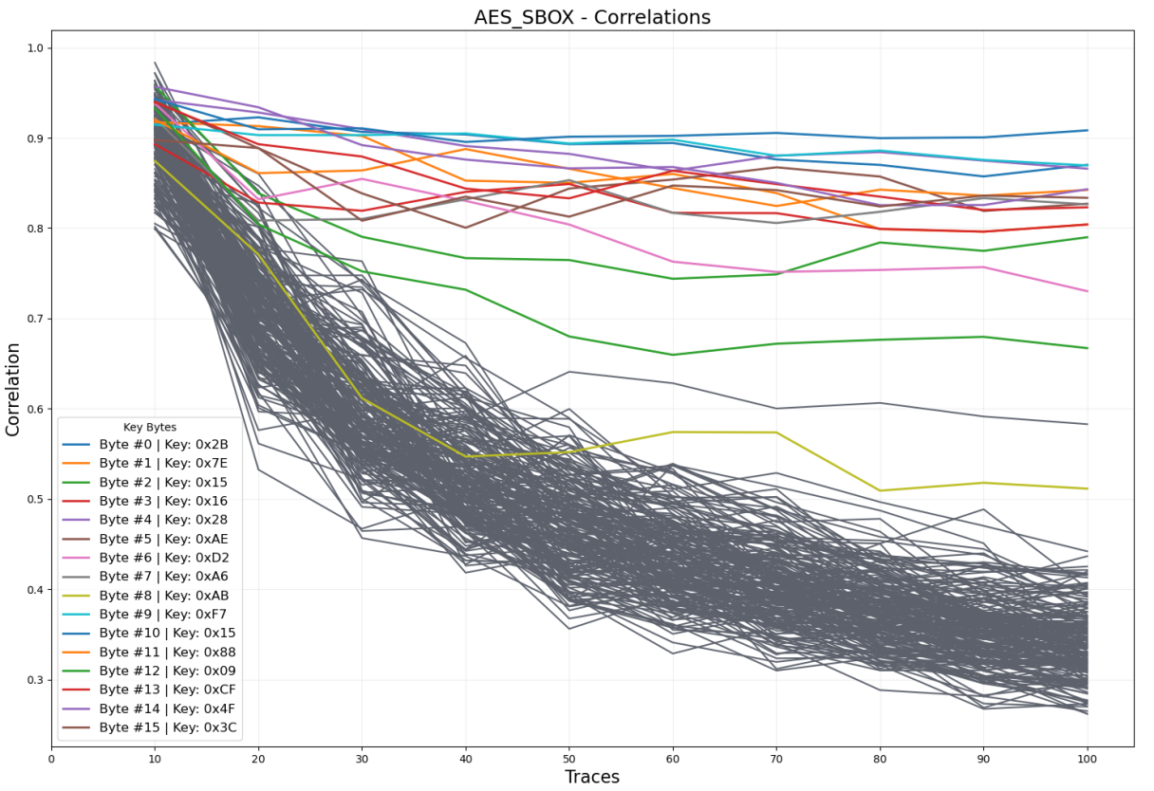
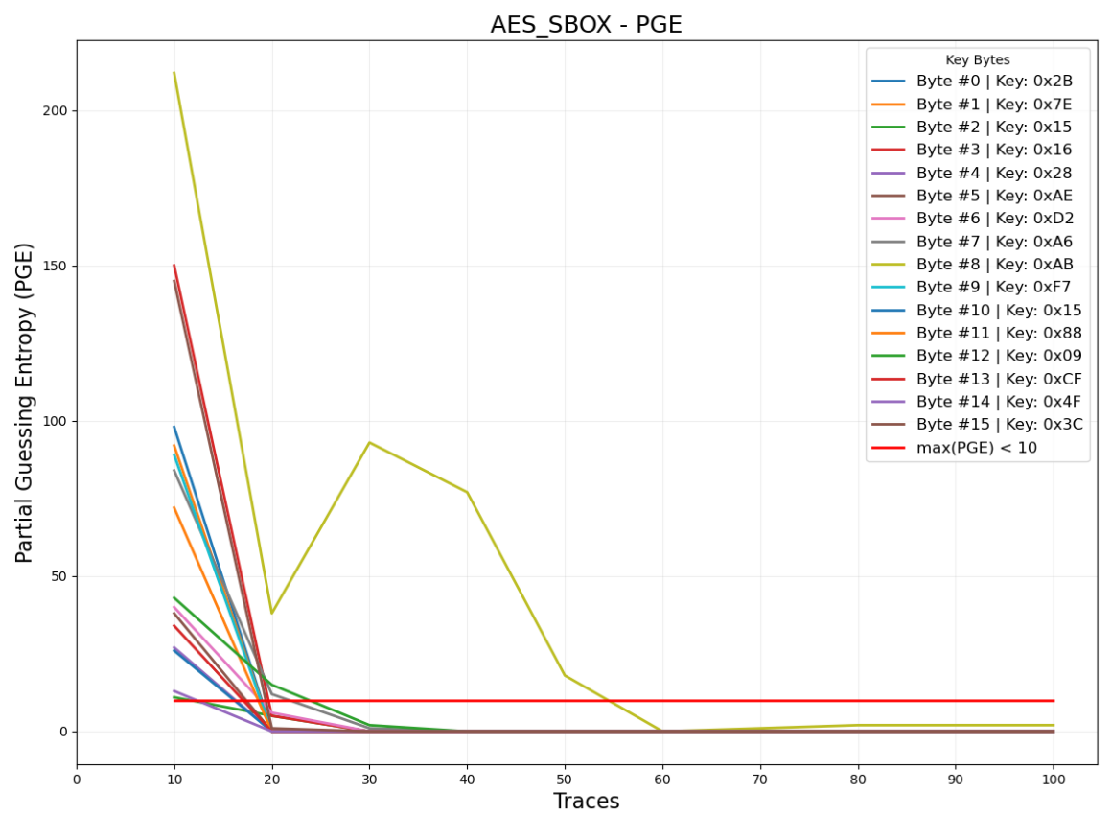
Results: 100 traces - AES S-Box
Confusion Coefficient: 0.11
Notes:
So let’s start from the results of the original AES S-Box.
On the left-hand side we can appreciate the correlation graph. In general, the higher the correlation the better the power traces relate with the power estimation computed by the attack.
In this case we can appreciate how distant are the colored traces from the grayed ones: the colored ones refer to the 16 bytes of the key, the others to all the wrong key candidates evaluated.
The more evident the separation among the two groups of traces the higher the success of the attack
The higher the number of traces the higher the separation among the two groups
On the right-hand side, the graph shows the partial guessing entropy, or PGE
To better understand this graph we firstly need to know that any CPA attack builds a rank sorting the best key candidates with the highest correlation scores
The PGE indicates how many places from the top one in the ranking the correct key is.
For instance, a PGE of 1 means that the correct key has the second highest value of correlation
In this graph, the faster the PGE drops to 0 and the faster the key is retrieved

Slide 10
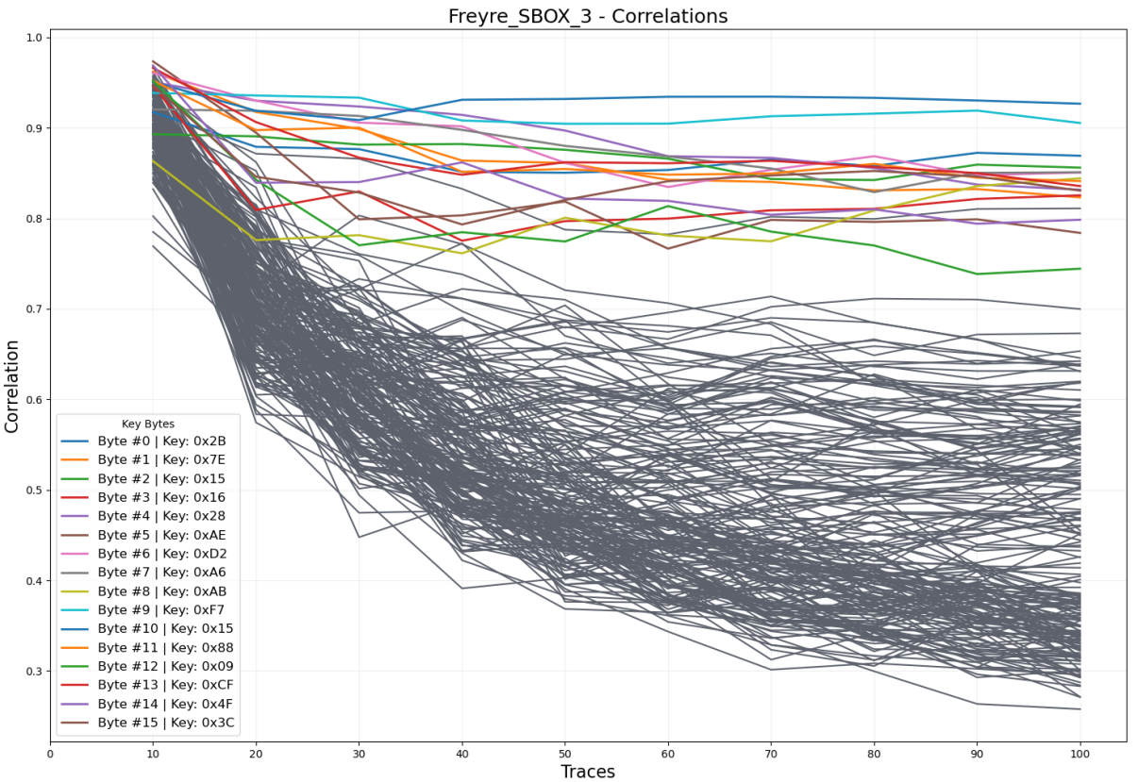
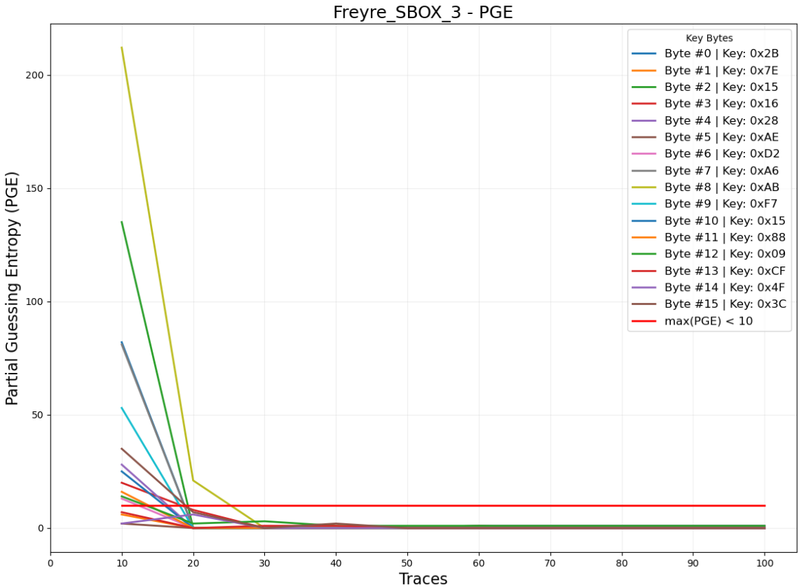
Results: 100 traces - Freyre S-Box #3
Confusion Coefficient: 1.93
Notes:
In this series of plots, related to Freyre’s third sbox, we can see, on the left-hand side graph, how the separation among the correct key traces and the wrong ones starts to become less effective.
However, the trace confusion is still not sufficient, as all the colored traces are all isolated from the other ones, meaning that the key can be easily retrieved
It is however interesting to see that the Confusion Coefficient of 2 starts to produce its effects
And in fact, if we look on the PGE graph, all the bytes of the key are found within 30 traces, even worse than AES S-Box

Slide 11
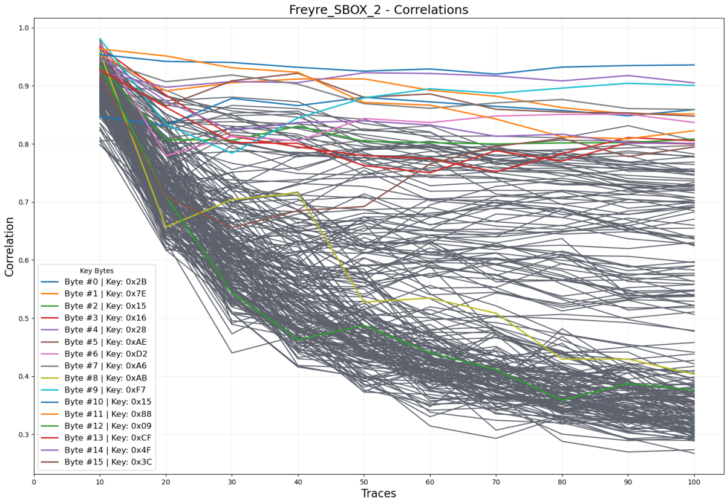
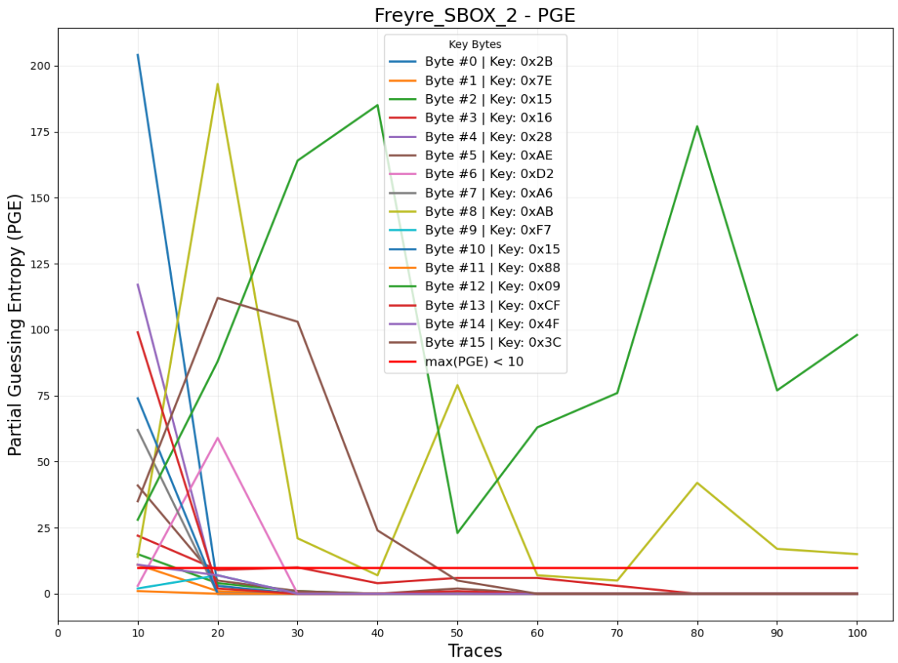
Results: 100 traces - Freyre S-Box #2
Confusion Coefficient: 4.49
Notes:
Here things start to really look interesting
Notice how the traces in the left-hand side graph are all scrambled all together, the Confusion Coefficient is 4.5 and an improved uniformity in the correlation traces is pretty evident
Notice how byte #8 and byte #12 (yellow and green traces) actually follow the group of incorrect key guesses
These results are also reflected in the PGE graph: even with 100 traces, 2 out of 16 bytes of the key are far from being recognized as correct key guesses

Slide 12
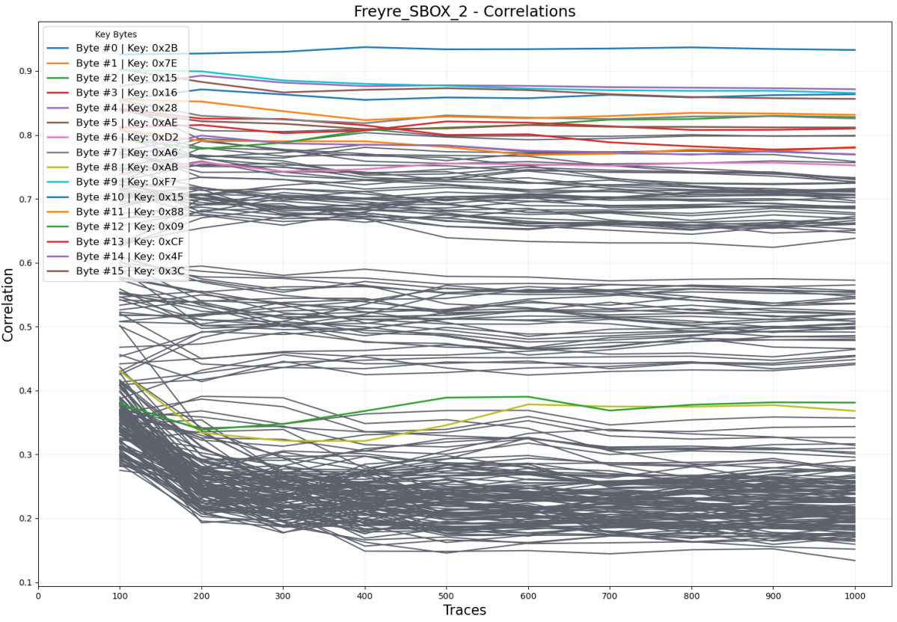
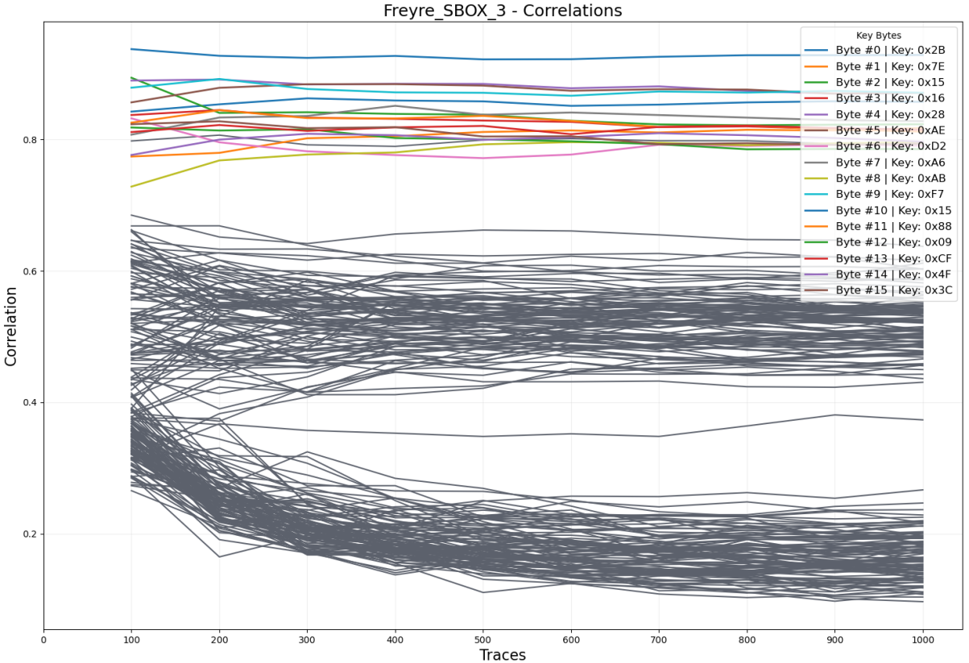
Results: 1000 traces - Freyre S-Box #2 vs. #3
Confusion Coefficient: 4.49
Confusion Coefficient: 1.93
Notes:
What if we capture 1000 traces (similar results, even more evident, were obtained with 5000 traces)
As we can see both Freyre structures tend to distribute their correlation into 3 main stripes, with the correct key guesses being the higher one (meaning that the key is foud)

Slide 13
Conclusions,
Future Work
Resistance to Side-Channel Analysis (SCA):
S-Boxes w/ CC = 5:
  impressive results
  # of Traces: increased by a factor 4 ÷ 10
S-Boxes w/ CC = 2:
  results are not satisfactory enough
  # of Traces: no real improvements w.r.t. AES S-Box
S-Boxes w/ no design criteria against SCA:
  poor results, as predicted
  # of Traces: 30-40 synchronously captured
Future Work:
Define empirical metrics to benchmark S-Boxes
Relate other theoretical metrics to empirical results
Repeat the analysis with a different device

Slide 14
Thank You!
Q&A
Empirical Evaluation of the Resilience of Novel S-Box Implementations Against Power Side-Channel Attacks
Candidate: Samuele Yves Cerini
Supervisor: Paolo Ernesto Prinetto

